Slide 1
Informed search algorithms
Chapter 4

Slide 2
Material
Chapter 4 Section 1 - 3
Exclude memory-bounded heuristic search

Slide 3
Outline
Best-first search
Greedy best-first search
A* search
Heuristics
Local search algorithms
Hill-climbing search
Simulated annealing search
Local beam search
Genetic algorithms

Slide 4
Review: Tree search
\input{\file{algorithms}{tree-search-short-algorithm}}
A search strategy is defined by picking the order of node expansion

Slide 5
Best-first search
Idea: use an evaluation function f(n) for each node
  estimate of "desirability"
  Expand most desirable unexpanded node
Implementation:
Order the nodes in fringe in decreasing order of desirability
Special cases:
  greedy best-first search
  A* search

Slide 6

Romania with step costs in km

Slide 7
Greedy best-first search
Evaluation function f(n) = h(n) (heuristic)
= estimate of cost from n to goal
e.g., h_{SLD}(n) = straight-line distance from n to Bucharest
Greedy best-first search expands the node that appears to be closest to goal

Slide 8

Greedy best-first search example

Slide 9

Greedy best-first search example

Slide 10

Greedy best-first search example

Slide 11

Greedy best-first search example

Slide 12
Properties of greedy best-first search
Complete? No – can get stuck in loops, e.g., Iasi → Neamt → Iasi → Neamt →
Time? O(b^{m}), but a good heuristic can give dramatic improvement
Space? O(b^{m}) -- keeps all nodes in memory
Optimal? No

Slide 13
A* search
Idea: avoid expanding paths that are already expensive
Evaluation function f(n) = g(n) + h(n)
g(n) = cost so far to reach n
h(n) = estimated cost from n to goal
f(n) = estimated total cost of path through n to goal

Slide 14

A* search example

Slide 15

A* search example

Slide 16

A* search example

Slide 17

A* search example

Slide 18

A* search example

Slide 19

A* search example

Slide 20
Admissible heuristics
A heuristic h(n) is admissible if for every node n,
h(n) ≤ h*(n), where h*(n) is the true cost to reach the goal state from n.
An admissible heuristic never overestimates the cost to reach the goal, i.e., it is optimistic
Example: h_{SLD}(n) (never overestimates the actual road distance)
Theorem: If h(n) is admissible, A* using TREE-SEARCH is optimal

Slide 21
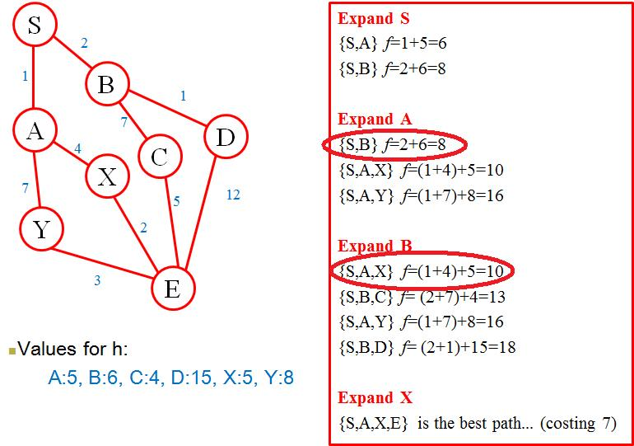
A* star Examples

Slide 22
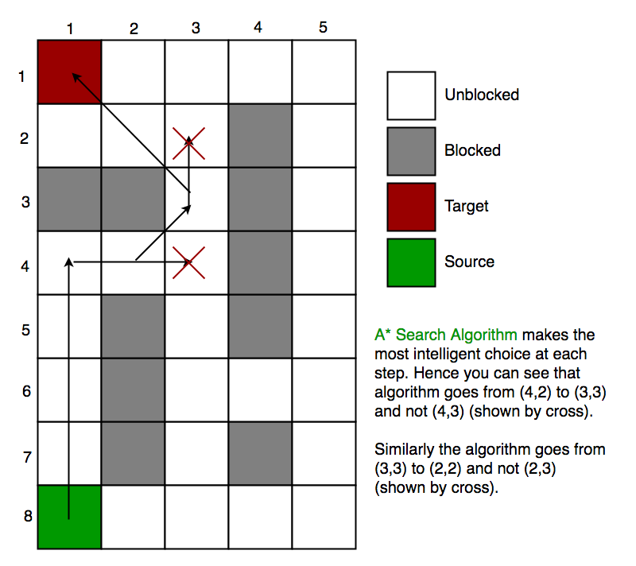
A* star Examples

Slide 23
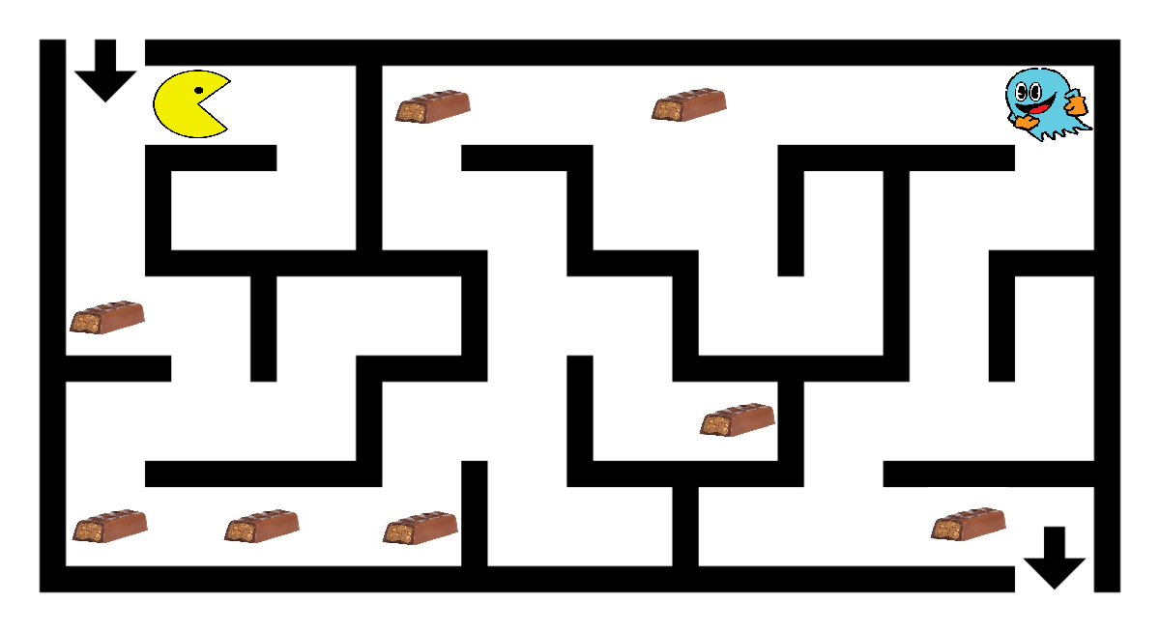
A* star Examples

Slide 24
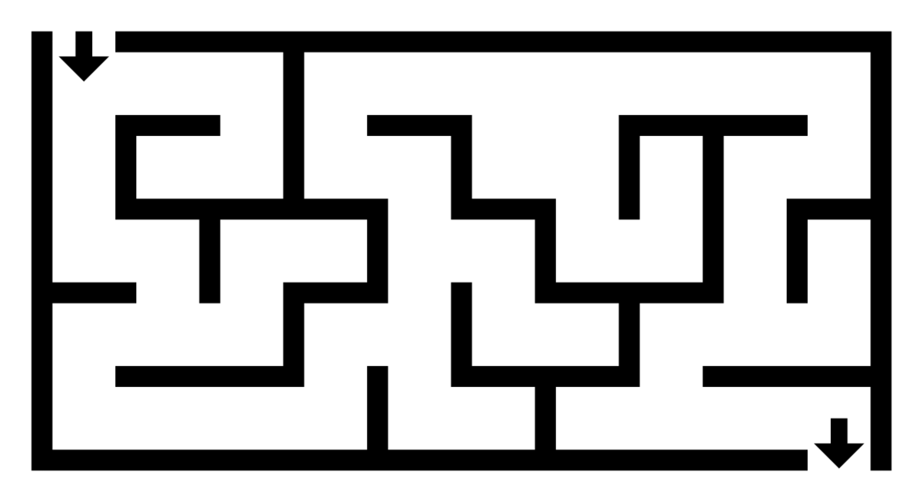
A* star Examples

Slide 25
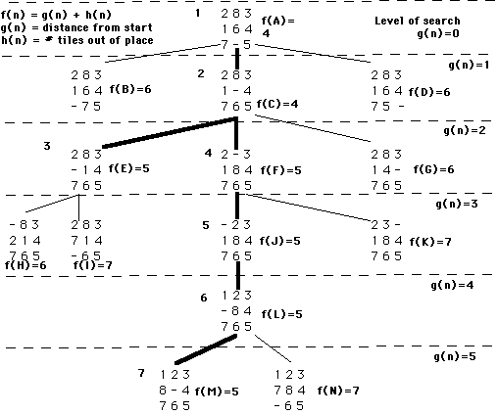
A* star Examples

Slide 26
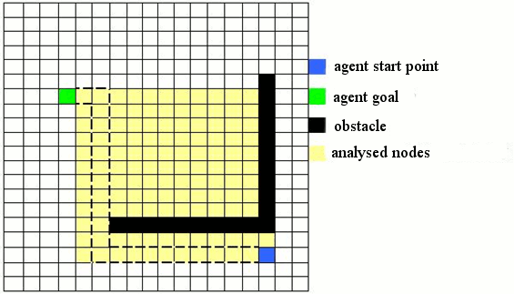
A* star Examples

Slide 27
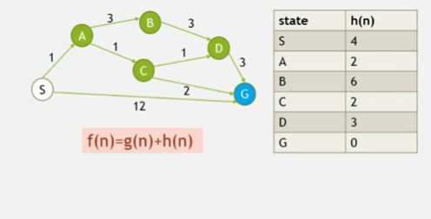
A* star Examples

Slide 28
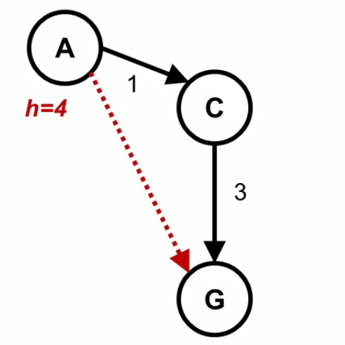
Admissible Heuristics

Slide 29
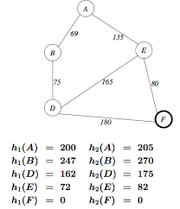
Admissible Heuristics

Slide 30

Optimality of A* (proof)
Suppose some suboptimal goal G₂ has been generated and is in the fringe. Let n be an unexpanded node in the fringe such that n is on a shortest path to an optimal goal G.
f(G₂) = g(G₂) since h(G₂) = 0
g(G₂) > g(G) since G₂ is suboptimal
f(G) = g(G) since h(G) = 0
f(G₂) > f(G) from above

Slide 31
Optimality of A* (proof)
Suppose some suboptimal goal G₂ has been generated and is in the fringe. Let n be an unexpanded node in the fringe such that n is on a shortest path to an optimal goal G.
f(G₂) > f(G) from above
h(n) ≤ h^*(n) since h is admissible
g(n) + h(n) ≤ g(n) + h*(n)
f(n) ≤ f(G)
Hence f(G₂) > f(n), and A* will never select G₂ for expansion

Slide 32

Consistent heuristics
A heuristic is consistent if for every node n, every successor n' of n generated by any action a,
h(n) ≤ c(n,a,n') + h(n')
h(n) – h(n’) <= c(n, n’)
If h is consistent, we have
f(n') = g(n') + h(n')
= g(n) + c(n,a,n') + h(n')
≥ g(n) + h(n)
= f(n)
i.e., f(n) is non-decreasing along any path.
Theorem: If h(n) is consistent, A* using GRAPH-SEARCH is optimal

Slide 33

Optimality of A*
A* expands nodes in order of increasing f value
Gradually adds "f-contours" of nodes
Contour i has all nodes with f=f_{i}, where f_{i} < f_{i+1}

Slide 34
Properties of A$^*$
Complete? Yes (unless there are infinitely many nodes with f ≤ f(G) )
Time? Exponential
Space? Keeps all nodes in memory
Optimal? Yes

Slide 35

Admissible heuristics
E.g., for the 8-puzzle:
h₁(n) = number of misplaced tiles
h₂(n) = total Manhattan distance
(i.e., no. of squares from desired location of each tile)
h₁(S) = ?
h₂(S) = ?

Slide 36
Admissible heuristics
E.g., for the 8-puzzle:
h₁(n) = number of misplaced tiles
h₂(n) = total Manhattan distance
(i.e., no. of squares from desired location of each tile)
h₁(S) = ? 8
h₂(S) = ? 3+1+2+2+2+3+3+2 = 18

Slide 37
Dominance
If h₂(n) ≥ h₁(n) for all n (both admissible)
then h₂ dominates h₁
h₂ is better for search
Typical search costs (average number of nodes expanded):
d=12 IDS = 3,644,035 nodes
A*(h₁) = 227 nodes
A*(h₂) = 73 nodes
d=24 IDS = too many nodes
A*(h₁) = 39,135 nodes
A*(h₂) = 1,641 nodes

Slide 38
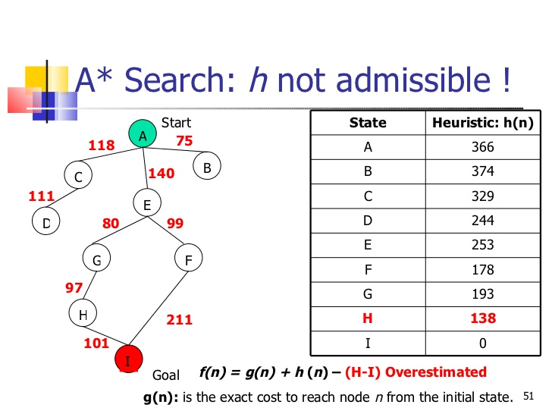
Dominance

Slide 39
Relaxed problems
A problem with fewer restrictions on the actions is called a relaxed problem
The cost of an optimal solution to a relaxed problem is an admissible heuristic for the original problem
If the rules of the 8-puzzle are relaxed so that a tile can move anywhere, then h₁(n) gives the shortest solution
If the rules are relaxed so that a tile can move to any adjacent square, then h₂(n) gives the shortest solution

Slide 40
Local search algorithms
In many optimization problems, the path to the goal is irrelevant; the goal state itself is the solution
State space = set of "complete" configurations
Find configuration satisfying constraints, e.g., n-queens
In such cases, we can use local search algorithms
keep a single "current" state, try to improve it

Slide 41

Example: n-queens
Put n queens on an n × n board with no two queens on the same row, column, or diagonal

Slide 42

Hill-climbing search
"Like climbing Everest in thick fog with amnesia"

Slide 43

Hill-climbing search
Problem: depending on initial state, can get stuck in local maxima

Slide 44

Hill-climbing search: 8-queens problem
h = number of pairs of queens that are attacking each other, either directly or indirectly
h = 17 for the above state

Slide 45

Hill-climbing search: 8-queens problem
A local minimum with h = 1

Slide 46

Simulated annealing search
Idea: escape local maxima by allowing some "bad" moves but gradually decrease their frequency

Slide 47
Properties of simulated annealing search
One can prove: If T decreases slowly enough, then simulated annealing search will find a global optimum with probability approaching 1
Widely used in VLSI layout, airline scheduling, etc

Slide 48
Local beam search
Keep track of k states rather than just one
Start with k randomly generated states
At each iteration, all the successors of all k states are generated
If any one is a goal state, stop; else select the k best successors from the complete list and repeat.

Slide 49
Genetic algorithms
A successor state is generated by combining two parent states
Start with k randomly generated states (population)
A state is represented as a string over a finite alphabet (often a string of 0s and 1s)
Evaluation function (fitness function). Higher values for better states.
Produce the next generation of states by selection, crossover, and mutation

Slide 50

Genetic algorithms
Fitness function: number of non-attacking pairs of queens (min = 0, max = 8 × 7/2 = 28)
24/(24+23+20+11) = 31%
23/(24+23+20+11) = 29% etc

Slide 51

Genetic algorithms

